Slide 1
Essential ODS PDF
Patrick Thornton

Slide 2
About this Presentation
ODS PDF capabilities I’ve found most valuable
Upper case indicates SAS syntax, e.g. PROC
Lower case indicates names of my choosing
Red indicates syntax of specific interest
… indicates syntax has been excluded to save space

Slide 3
Essential ODS PDF: Outline
Creating a PDF
Setting page options, titles and footnotes
Capturing results from PROCs as data
Selecting or excluding PROC results
Simultaneously creating multiple PDFs
Example incorporating PROC REPORT

Slide 4
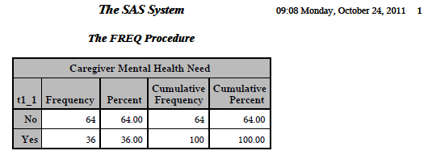
Creating a PDF
ODS PDF FILE= "&sasexport.example1.pdf";
  PROC FREQ DATA=services;
  TABLE t1_1;
  RUN;
ODS PDF CLOSE;

Slide 5
Creating a PDF: Summary of Options
Name it with: File =
Control the overall look with: Style =
Add metadata with: Author=, Title=, Subject=, Keywords=
Consolidate the output with:
Startpage=, Columns=
Simultaneously create two PDF with: Id =

Slide 6
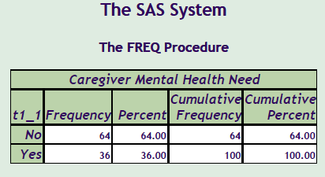
Creating a PDF: Style
ODS PDF FILE="&sasexport.example2.pdf" STYLE=OCEAN;
  PROC FREQ DATA=services;
  TABLE t1_1;
  RUN;
ODS PDF CLOSE;

Slide 7
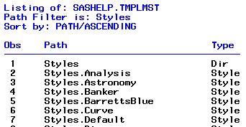
Creating a PDF: Style Listing
PROC TEMPLATE;
LIST STYLES;
RUN;
e.g. SASDOCPRINTER, MINIMAL

Slide 8
Creating a PDF: Customize a Style
PROC TEMPLATE;
DEFINE STYLE myocean; PARENT= styles.ocean;
REPLACE TABLE FROM OUTPUT/
FRAME = void
RULES = rows
CELLPADDING = 3pt
CELLSPACING = 0.0pt
BORDERWIDTH = 0.2pt;
END;
RUN;

Slide 9
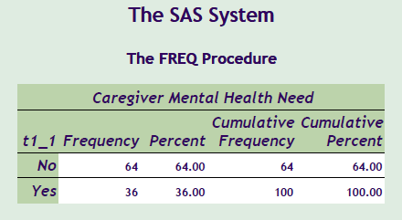
Creating a PDF: Customize a Style (con’t)
ODS PDF FILE="&sasexport.example2a.pdf" STYLE=myocean;
  PROC FREQ DATA=services;
  TABLE t1_1;
  RUN;
ODS PDF CLOSE;

Slide 10
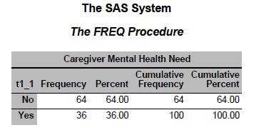
Creating a PDF: Customize a Style (con’t)

Slide 11
Creating a PDF: Summary of Options
Name it with: File =
Control the overall look with: Style =
Add metadata with: Author=, Title=, Subject=, Keywords=
Consolidate the output with:
Startpage=, Columns=
Simultaneously create two PDF with:
Id =

Slide 12
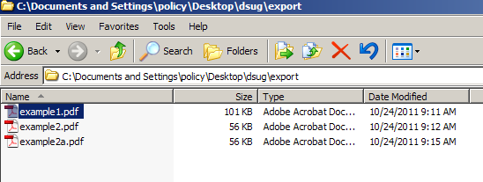
Creating a PDF: Metadata

Slide 13
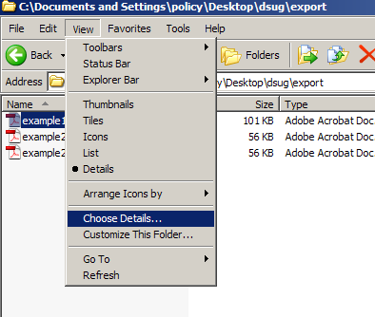
Creating a PDF: Metadata (con’t)

Slide 14
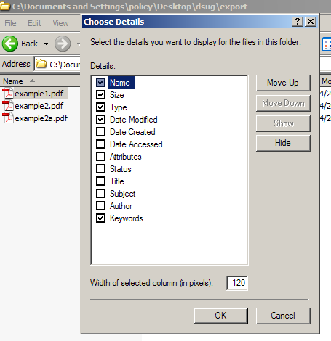
Creating a PDF: Metadata (con’t)

Slide 15
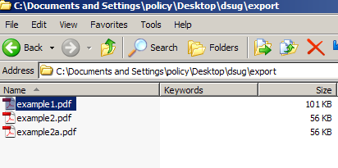
Creating a PDF: Metadata (con’t)

Slide 16
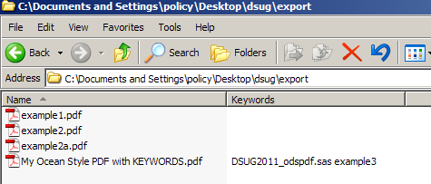
Creating a PDF: Metadata
%LET programname = %SYSGET(SAS_EXECFILENAME);
%LET mytitle = My Ocean Style PDF with KEYWORDS;
ODS PDF FILE="&sasexport.&mytitle..pdf"
KEYWORDS="&programname example3";
  PROC FREQ …
ODS PDF CLOSE;

Slide 17
Creating a PDF: Summary of Options
Name it with: File =
Control the overall look with: Style =
Add metadata with: Author=, Title=, Subject=, Keywords=
Consolidate the output with:
Startpage=, Columns=
Simultaneously create two PDF with:
Id =

Slide 18
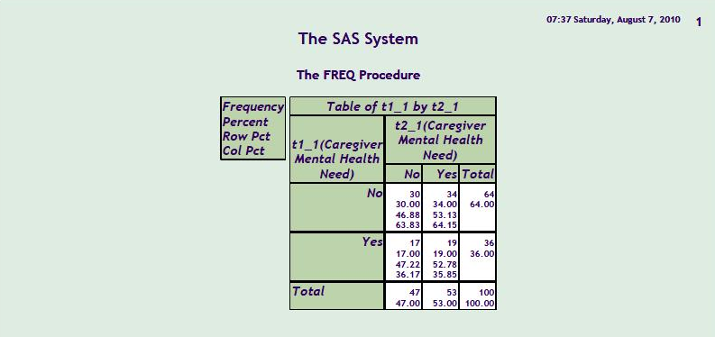
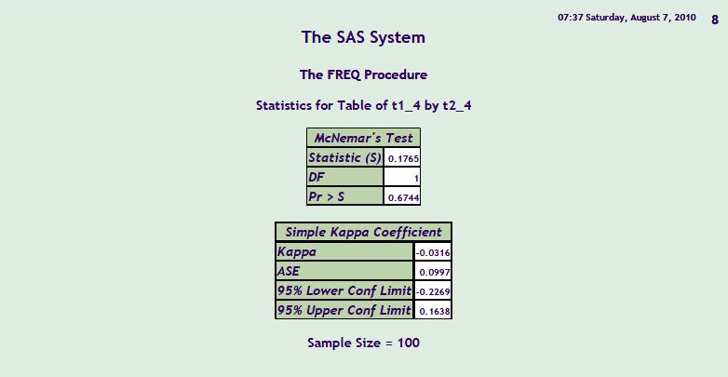
Creating a PDF: Consolidating
ODS PDF FILE="&sasexport.example4.pdf" STYLE=OCEAN;
PROC FREQ DATA=services;
TABLE t1_1 * t2_1/AGREE;
RUN;
…PROC t1_2*t2_2, t1_3*t2_3, t1_4*t2_4
ODS PDF CLOSE;

Slide 19
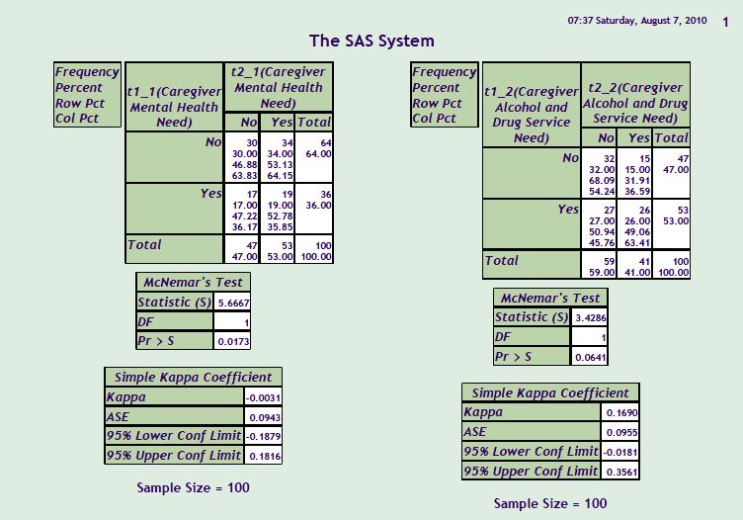
Creating a PDF: Consolidating
ODS PDF FILE="&sasexport.example4b.pdf" STYLE=OCEAN COLUMNS=2 ;
ODS NOPROCTITLE;
PROC FREQ DATA=services NOTITLE;
TABLE t1_1 * t2_1/AGREE;
RUN;
[repeat PROC t1_2*t2_2, t1_3*t2_3, t1_4*t2_4]
ODS PDF CLOSE;

Slide 20
Essential ODS PDF: Outline
Creating a PDF
Setting page options, titles and footnotes
Capturing results from PROCs as data
Selecting or excluding PROC results
Simultaneously creating multiple PDFs
Example incorporating PROC REPORT

Slide 21
Options, Titles and Footnotes
OPTIONS
  Remove date with: NODATE
  Remove page number with: NONUMBER
  Set orientation with ORIENTATION=
In line styles TITLE and FOOTNOTE:
  Set size with HEIGHT=
  Set horizontal position with J=
  Set font with F=
  Customize with ODS ESCAPECHAR=

Slide 22
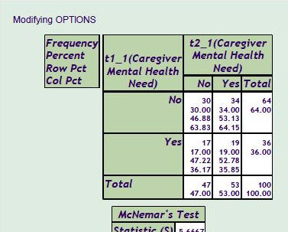
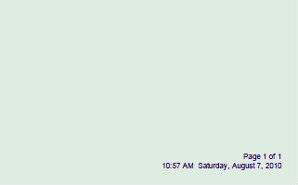
Options, Titles & Footnotes (con’t)
OPTIONS ORIENTATION=LANDSCAPE NODATE NONUMBER ;
TITLE1 HEIGHT=12PT J=LEFT F=ARIAL "Modifying OPTIONS";
FOOTNOTE1 HEIGHT=8PT J=RIGHT F=ARIAL
"Page ^{thispage} of ^{lastpage} ";
ODS PDF FILE="&sasexport.example5.pdf“ STYLE=…;
ODS ESCAPECHAR='^‘ ; ODS NOPROCTITLE;
PROC FREQ…
ODS PDF CLOSE;

Slide 23
Options, Titles & Footnotes (con’t)
%macro repnow ;
%local d t ;
%let d = %sysfunc( date( ), weekdate29 );
%let t = %sysfunc( time( ), timeampm8 );
&t &d
%mend repnow;
%let ff = HEIGHT=8PT J=RIGHT F=ARIAL;
FOOTNOTE1 &ff "Page ^{thispage} of ^{lastpage}";
FOOTNOTE2 &ff "%repnow";

Slide 24
Essential ODS PDF: Outline
Creating a PDF
Setting page options, titles and footnotes
Capturing results from PROCs as data
Selecting or excluding PROC results
Simultaneously creating multiple PDFs
Example incorporating PROC REPORT

Slide 25
PROC Results to Data: TRACE
ODS TRACE ON;
PROC FREQ DATA=services;
TABLE t1_1 * t2_1;
RUN;
ODS TRACE OFF;
Partial Log Output
Name: CrossTabFreqs

Slide 26
PROC Results to Data: TRACE (con’t)
ODS TRACE ON;
PROC FREQ DATA=services;
TABLE t1_1 * t2_1/AGREE ;
RUN;
ODS TRACE OFF;
Log Output Names
CrossTabFreqs
McNemarsTest
SimpleKappa

Slide 27
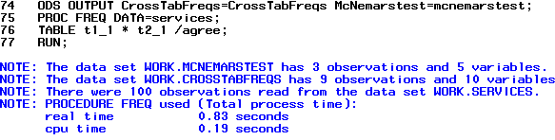
PROC Results to Data: Output
ODS OUTPUT
CROSSTABFREQS= CrossTabFreqs
MCNEMARSTEST = McNemarsTest;
PROC FREQ DATA=services;
TABLE t1_1 * t2_1/AGREE;
RUN;
ODS OUTPUT CLOSE;

Slide 28
Essential ODS PDF: Outline
Creating a PDF
Setting page options, titles and footnotes
Capturing results from PROCs as data
Selecting or excluding PROC results
Simultaneously creating multiple PDFs
Example incorporating PROC REPORT

Slide 29
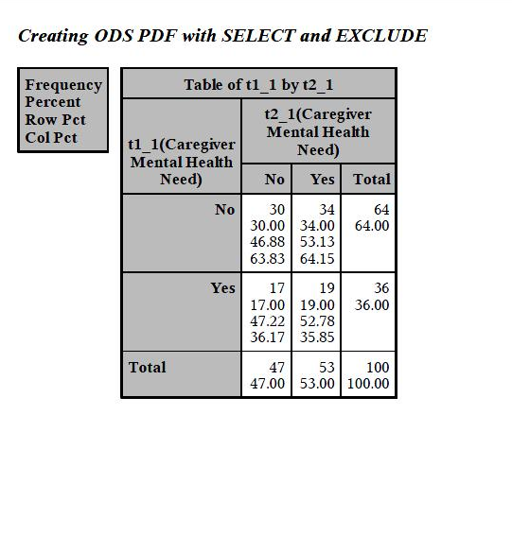
Selecting or Excluding PROC Results
ODS PDF FILE="&sasexport.Example 6.pdf" …;
ODS PDF SELECT WHERE=(_NAME_ in ('CrossTabFreqs'));
PROC FREQ DATA=services;
TABLE t1_1 * t2_1/AGREE;
RUN;
ODS PDF CLOSE;

Slide 30
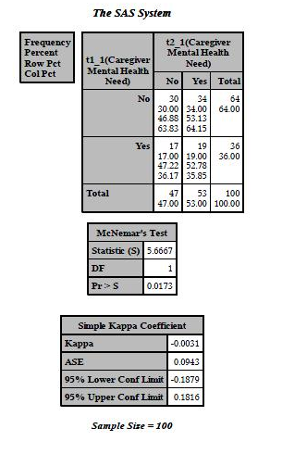
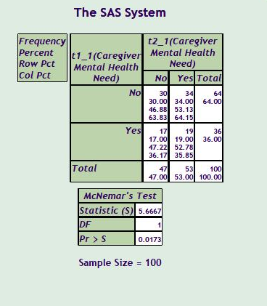
Simultaneously creating multiple PDFs
ODS PDF (ID=long) FILE="&sasexport.Example 7a.pdf" ;
ODS PDF (ID=short) FILE="&sasexport.Example 7b.pdf" STYLE=OCEAN;
ODS PDF (ID=short) EXCLUDE WHERE=(_name_ in ('SimpleKappa'));
  PROC FREQ DATA=services NOTITLE;
  TABLE t1_1 * t2_1/AGREE;
  RUN;
ODS PDF (ID=short) CLOSE;
ODS PDF (ID=long) CLOSE;

Slide 31
Example: SELECT/EXCLUDE & OUTPUT
ODS PDF (ID=lis) FILE="&sasexport.Example 8a.pdf" ;
ODS PDF (ID=nice) FILE="&sasexport.Example 8b.pdf" STYLE=OCEAN;
ODS PDF (ID=nice) EXCLUDE _ALL_;
ODS OUTPUT CROSSTABFREQS= CrossTabFreqs
(rename=(t1_1=var1 t2_1=var2))
MCNEMARSTEST = McNemarsTest;
PROC FREQ DATA=services;
TABLE t1_1 * t2_1/AGREE;
RUN;
ODS OUTPUT CLOSE;
ODS PDF (ID=lis) EXCLUDE _ALL_;
ODS PDF (ID=nice) SELECT WHERE=(_NAME_ in (‘Report’));

Slide 32
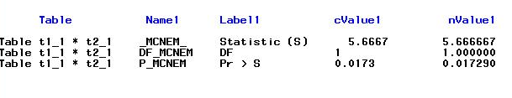
Example: McNemar’s Test
PROC SQL NOPRINT;
SELECT CATX('=',label1,cvalue1)
INTO: mc SEPARATED BY ‘ ' FROM McNemarsTest;
QUIT;
%PUT &mc;
Statistic (S)=5.6667 DF=1 Pr > S=0.0173

Slide 33
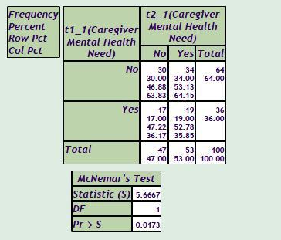
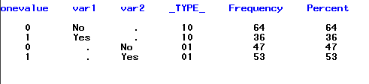
Example: Marginal N and Percent from CrossTabFreqs
data CrossTabFreqs;
set CrossTabFreqs;
if var1 = . then onevalue = var2;
else if var2 = . then onevalue = var1 ;
if (_type_ ='01' and var1 =.)
or (_type_ ='10' and var2 =. );
run;

Slide 34
Example: Cross Tab Freqs

Slide 35
Example: SELECT/EXCLUDE & OUTPUT
ODS PDF (ID=lis) FILE="&sasexport.Example 8a.pdf" ;
ODS PDF (ID=nice) FILE="&sasexport.Example 8b.pdf" STYLE=OCEAN;
ODS PDF (ID=nice) EXCLUDE _ALL_;
ODS OUTPUT CROSSTABFREQS= CrossTabFreqs
(rename=(t1_1=var1 t2_1=var2))
MCNEMARSTEST = McNemarsTest;
PROC FREQ DATA=services;
TABLE t1_1 * t2_1/AGREE;
RUN;
ODS OUTPUT CLOSE;
ODS PDF (ID=lis) EXCLUDE _ALL_;
ODS PDF (ID=nice) SELECT WHERE=(_NAME_ in (‘Report’));

Slide 36
Example: PROC REPORT
…PROC SQL to capture McNemar’s Test
…DATA step to limit CrossTabFreqs and create variable onevalue
PROC REPORT DATA=CrossTabFreqs nowd MISSING;
COL ("Table 1 Caregiver Mental Health Need" onevalue (_TYPE_), (frequency percent) );
DEFINE onevalue /GROUP 'Responses' STYLE=[CELLWIDTH=200] CENTER;
DEFINE _TYPE_ /ACROSS FORMAT=$timetype. "";
DEFINE FREQUENCY/ 'n' STYLE=[CELLWIDTH=70];
DEFINE PERCENT/'%' STYLE=[CELLWIDTH=70] FORMAT=5.1;

Slide 37
Example: PROC REPORT (CON’T)
PROC REPORT
…
RBREAK AFTER / OL SKIP SUMMARIZE SUPPRESS;
COMPUTE AFTER _PAGE_ /;
LINE “&mc";
ENDCOMP;
FORMAT onevalue yn.;
RUN;;
ODS PDF (ID=lis) CLOSE;
ODS PDF (ID=nice) CLOSE;

Slide 38
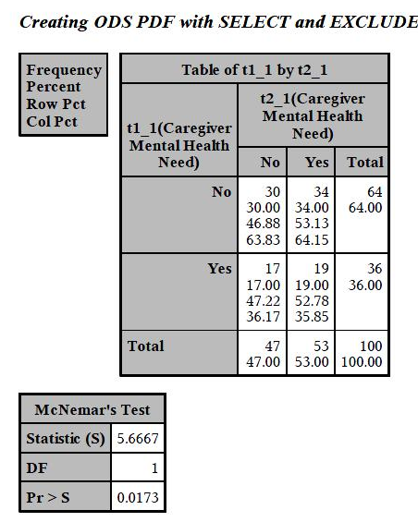
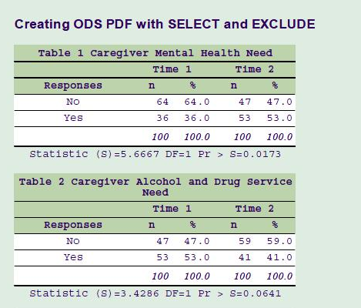
Example: Final Output

Slide 39
Essential ODS PDF:Conclusion
Creating a PDF
Setting page options, titles and footnotes
Capturing results from PROCs as data
Selecting or excluding PROC results
Simultaneously creating multiple PDFs
Example incorporating PROC REPORT

Slide 40
SAS®
The
Power
To Know™
SAS is a registered trademark or trademark of SAS Institute Inc. in the USA and other countries. ® indicates USA registration.
Other brand and product names are registered trademarks or Trademarks of their respective companies.

Slide 41
Contact Information
Patrick Thornton, Ph.D.
333 Ravenswood Ave
Menlo Park, CA 94025-3493
650 859-5583
Patrick.thornton@sri.com

